Slide 1
Spring Framework Introduction & Spring Core
Compiler: Lê Anh Vũ
Email: levu@yahoo-corp.jp

Slide 2
Agenda
Spring Core - IoC Container
Spring Core - Dependency Injection (DI)
Spring Core - Autowired
Spring Core - Qualifying

Slide 3
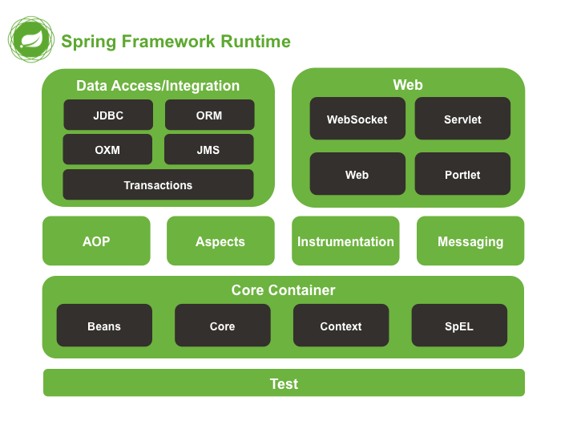
Spring Framework Introduction

Slide 4
Spring Framework Introduction
Other projects of Spring Framework
Spring MVC
Spring Security
Spring Boot
Spring Batch
Spring Social
Spring IO
Spring Cloud
Spring Mobile
Spring for Android
Spring Session

Slide 5
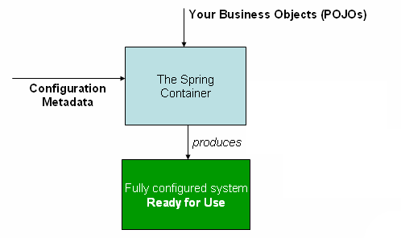
Spring Core - IoC Container
IoC (Inversion of Control)
Using design pattern Dependency Injection
The core package of IoC container:
org.springframework.beans (interface BeanFactory)
org.springframework.context (interface ApplicationContext)

Slide 6
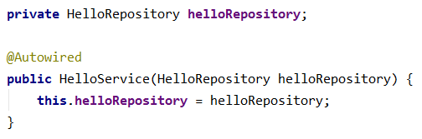
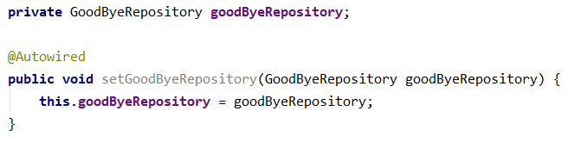
Spring Core - Dependency Injection (DI)
DI is a design pattern implemented according to IoC
Spring Framework supports 2 ways to implement DI:
DI by Constructor
DI by Setter

Slide 7
Spring Core - Autowired
Autowired: DI Automatically
Annotation: org.springframework.beans.factory.annotation.Autowired
4 autowiring mode:
No (Default): autowiring is off.
By Type
By Name
Constructor

Slide 8
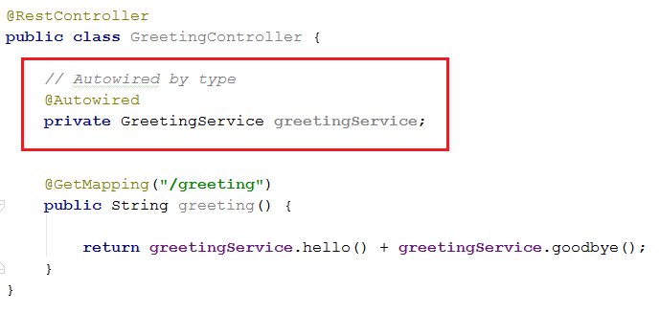
Spring Core - Autowired
Autowired by Type

Slide 9
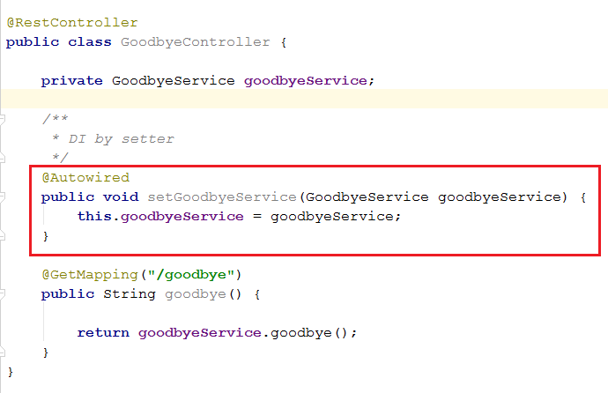
Spring Core - Autowired
Autowired by Name

Slide 10
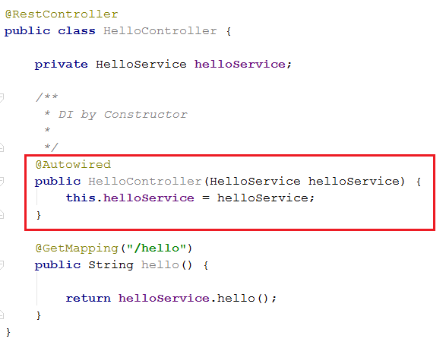
Spring Core - Autowired
Autowired by Constructor

Slide 11
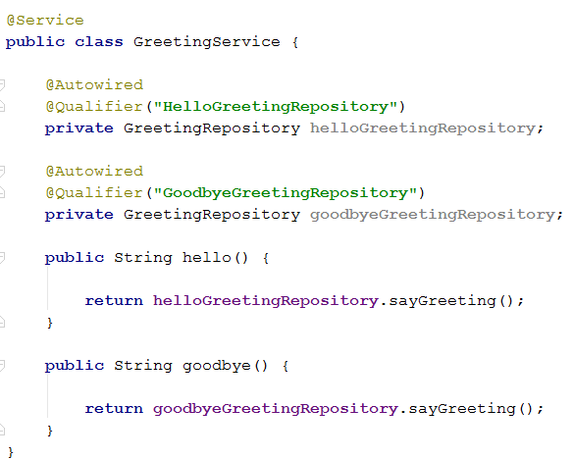
Spring Core - Qualifying
IoC cannot autowired when an interface has many implement
@Qualifier: To inject the correct bean by the bean name
annotation: org.springframework.beans.factory.annotation.Qualifier

